Slide 1
Ten Ways to Protect Our Kids from Fentanyl
From Understanding to Action
Cindy M. Cipriani
Senior Management Counsel/Outreach Director
Office of the U.S. Attorney
Co-Chair, PDATF
Notes:
[Introduce presenters]
Thank you for coming. Our reason for being here today is simple and clear -- we want to increase understanding about the dangerous rise of fentanyl so that we can come together to take action for our community and kids. San Diego is seeing a spike in overdoses and overdose deaths related to fentanyl.

Slide 2
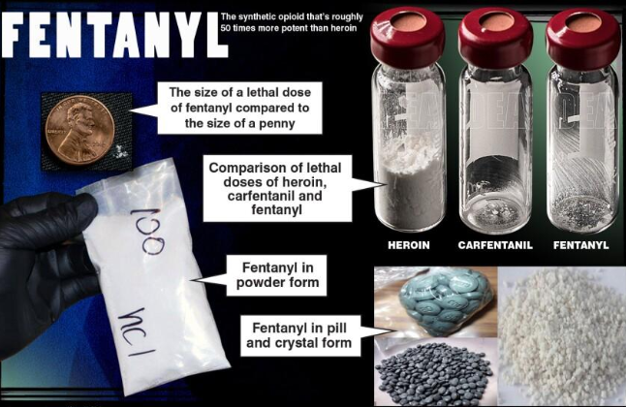
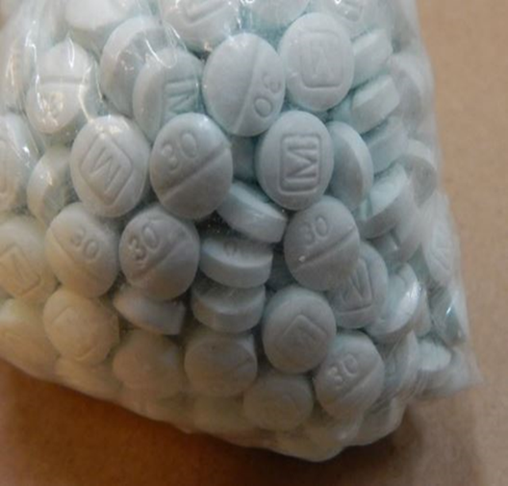
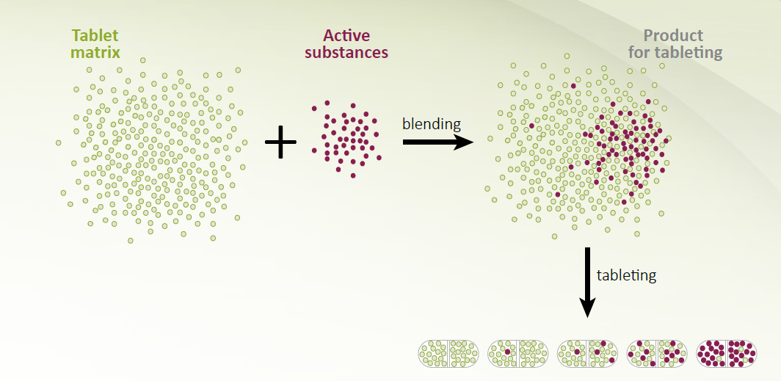
1) Help Kids Understand Fentanyl Mixing: Not FDA approved!
Notes:
Fentanyl comes both in powder and pill form.
These are examples of some of the illegally produced counterfeit pills that contain fentanyl.
They are designed to mimic legal prescription medication like Xanax or oxycodone, but they have none of the properties of the legal drug. These are counterfeit pills that contain fentanyl.
CLICK to show the image of mixing fentanyl in pills. One thing to keep in mind here is that when these counterfeit pills are being illegally made, the person making the pills has no idea how much fentanyl is in each pill. It’s kind of like making chocolate chip cookies. Some cookies may have more chocolate chips than others. In this case some of the pills may have a lot more fentanyl than others but the person using the pill would have no idea if the pill they are taking has a lot or a little fentanyl. Keeping in mind it only takes a little fentanyl to overdose.

Slide 3
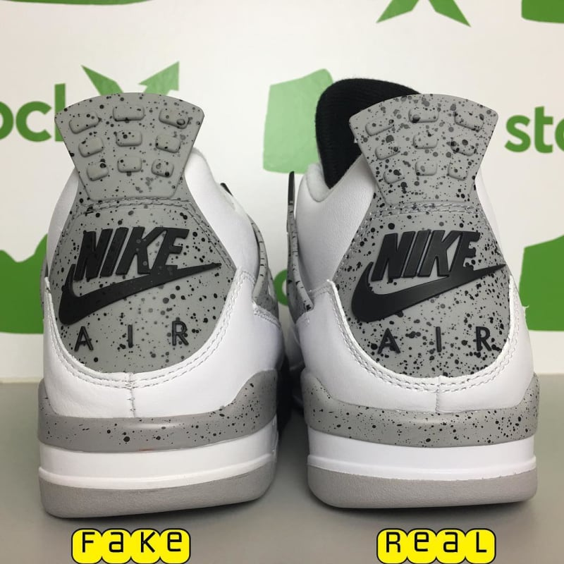
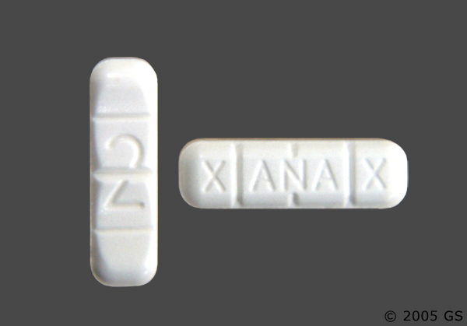
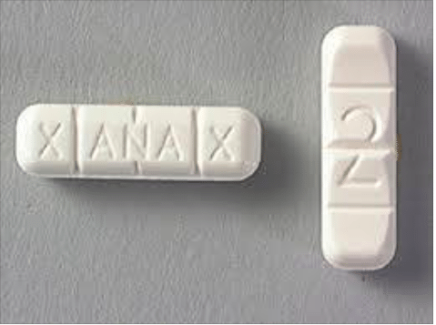
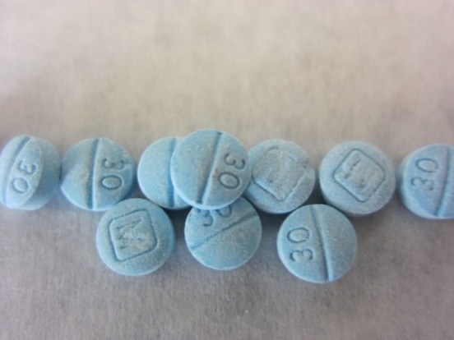
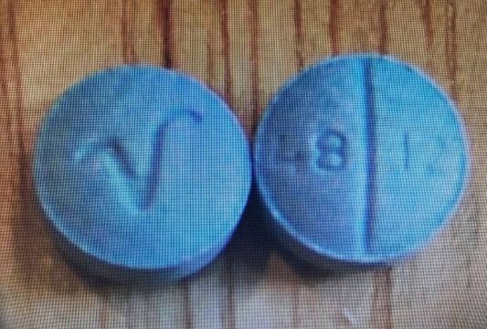
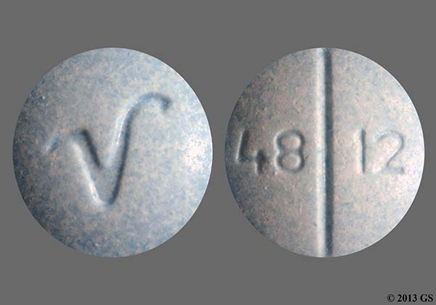
2) Ask Your Teen: Can You Spot the Real Thing?
1
2
FAKE
FAKE
FAKE
FAKE
FAKE
FAKE
FAKE
PERCOCET
FENTANYL-LACED PILLS
Notes:
Game: Can you spot the REAL THING?
Each click will reveal a set of pictures. Show the picture and ask students to hold up either 1 or 2 fingers for which side is the “Real Thing.” Click again to reveal which is the Fake. Alternate more interactive method: have students move to one side of the room or the other for which they believe is fake.
Demonstrate that sometimes Fakes are easy to identify, while others are difficult.
Continue until the numbers disappear and “Operation Blue Death” is revealed.
Explain that drug dealers and cartels make pills look so similar to legitimate prescription pills, that only pills directly from a pharmacist or doctor should be trusted. If these pills are laced with fentanyl, they can be deadly.

Slide 4
3) Monitor Social Media
Talk with kids about what they are seeing and posting
Take note of social media sites your child visits
Keep track of passwords and usernames
Set limits on the amount of time they are online
Notes:
Because so many of our teens are now getting pills and other substances via social media and texting, CLICK it’s very important to monitor social media sites. Before your child gets a social media account be sure they know that they need to ask your permission before joining one of the sites. CLICK
Ask your child for their usernames and passwords. CLICK
Keep track of those. CLICK
Set limits on how long you kids are spending online. CLICK
Talk with them about what people are talking about online and what their thoughts are on that.

Slide 5
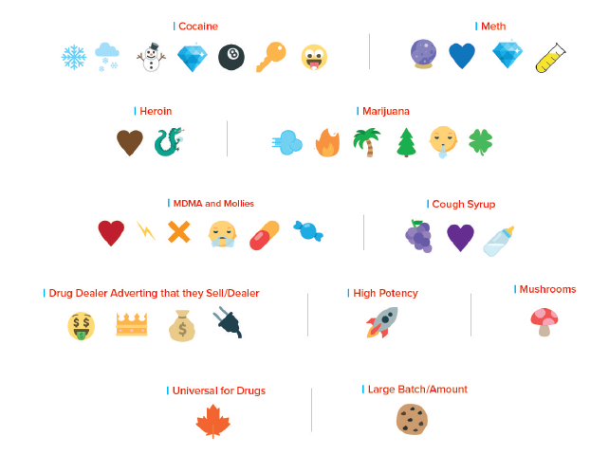
4. Look for Popular Emoji Drug Codes

Slide 6
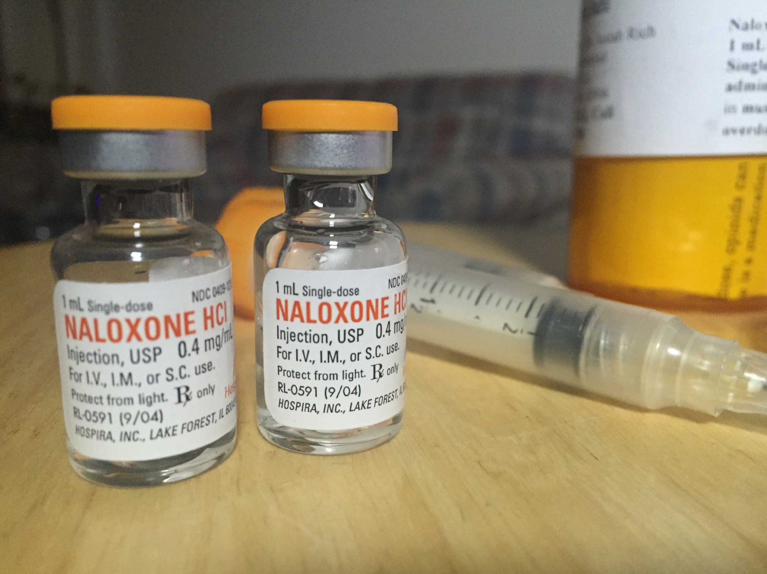
5) Know the Fentanyl Overdose Signs
Heavy nodding, deep sleep, hard to wake up, or vomiting
Slow or shallow breathing (less than 1 breath every 5 seconds), snoring, gurgling or choking sounds
Pale blue or gray lips, fingernails, or skin
Clammy, sweaty skin
Administer Naloxone to reverse an overdose, but always call 911 FIRST
Notes:
This is list of signs that can indicate an overdose. CLICK
Awake but unable to talk or are unresponsive to being touched or vomiting CLICK
Fentanyl effects the heart and lungs … As they slow down and weaken, the entire body can be affected.
Erratic breathing leads to snoring, gurgling or choking sounds. CLICK
The lips, fingernails or skin turns pale blue or gray CLICK
The skin can feel clammy or sweaty CLICK
If you encounter a person who is experiencing these effects the first thing to do is call 911.
It is important to note that Naloxone – can reverse an overdose.
Reversing an overdose can be the first step in getting a loved one into treatment.

Slide 7
6) Discuss the Good Samaritan Law
Under California Health and Safety Code 11376.5, a person will not be charged with drug possession or use crimes if that person: acts in good faith and seeks medical assistance/ emergency medical services for another person experiencing a drug-related overdose.
This law encourages any witness of a drug overdose to…
CALL 9-1-1 or SEEK HELP
To SAVE the life of an overdose victim.
Note that HSC 11376.5 does not protect a person from the following crimes: selling drugs, per HSC 11352, or driving under the influence of drugs, per VC 23152.

Slide 8
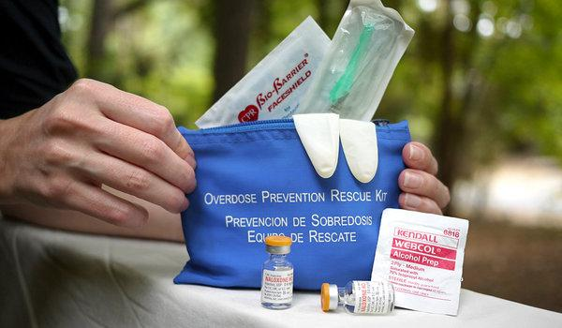
7) Add Naloxone to your First Aid Kit
Naloxone can save the life of a person experiencing an overdose
Naloxone counteracts opioids and can restore breathing and heart rate
Make it a part of your home first-aid kit: It’s easy to get a naloxone kit and get trained on how to use it
Notes:
Naloxone reverses the overdose by working to restore breathing and heart rate.
It is a critical tool that is used by first responders, but anyone can now get Naloxone and a prescription isn’t necessary. Just ask your pharmacist.
It’s important to always have Naloxone available just in case. Make it a part of your first-aid kit. It can be purchased at most pharmacies or acquired through community organizations offering training and free kits. Once you get it, remember to put it in a place where you will remember where it is.
Do not be afraid to have this in your home.
Find the nearest location by going to Sdpdatf.org
Our coalition offers free Naloxone kits, if you would like one, please see me after the presentation.

Slide 9
8) Talk Early. Talk Often. Two approaches
If exploring possible use:
Show concern rather than anger
Ask open-ended questions
Work to understand your teen’s point of view
When on notice of a drug problem:
Get on the same page
Prepare to be called a hypocrite
Gather any evidence
Expect anger, resolve to remain calm
Set a realistic goal
Establish clear rules and consequences
Recognize any addiction in the family
Notes:
While it seems like kids don’t listen, parents can have the power to affect their kids’ attitudes and behaviors around substance use.
Kids who learn about the risks of drugs and underage drinking at home are significantly less likely to use alcohol and other drugs than kids who don’t
And when kids are asked why they don’t use substances, many of them answer they don’t want to disappoint their parents.
You can protect your family by talking with your kids – from a young age to young adulthood.
You can be clear about your expectations and boundaries, but still have a positive conversation that keeps the door open to further discussion. Some of the ways to do this are by:CLICK
* Teens can be frustrating – in many ways – but what you probably feel most for your teen is love and concern. Let them know that. CLICK
* Ask open ended questions. “Tell me about your night” vs. “Where were you” CLICK
* Again, it can be hard, but work to understand your teen’s point of view. Let’s say that your teen wants to go to a concert, but you don’t want them to go. You can say “help me understand … why is this so important to you?” It doesn’t mean that you will do what they want, but there is a better chance that they will feel heard. CLICK
Finally, keep talking, no matter what. Maintaining some connection – even when a relationship is contentious, or if use does start – is very important. CLICK
Establish a rescue plan with your child. This can be a secret text or phrase that you and your child agree on. If they text you with the code word or call you with a code phrase, that’s your cue that they are in a situation and need your help to get out. An example might be if your child’s code phrase is, I forgot to feed the dog. When you see that message in a text or if your child tells you that in a phone call, you’ll know that’s code for come and get me. You might respond with something like, “that’s the 3rd time this week you’ve forgotten to feed the dog, and it’s your responsibility where are you, I’m coming to get you right now.”
Ask the audience, do any of you have a rescue plan with your child. Ask if they would be willing to share.

Slide 10
9. Establish a Text/Call Rescue Plan
Teen sends a simple text: “X”
Parent calls teen: “Something has come up at home. I need to come and get you.”
Notes:
A youth counselor asked teens a simple question: “How many of you have found yourself in situations where things started happening that you weren’t comfortable with, but you stuck around, mainly because you felt like you didn’t have a way out?”
They all raised their hands.
he one who receives the text has a very basic script to follow. Within a few minutes, they call Danny’s phone. When he answers, the conversation goes like this:
“Hello?”
“Danny, something’s come up and I have to come get you right now.”
“What happened?”
“I’ll tell you when I get there. Be ready to leave in five minutes. I’m on my way.”
At that point, Danny tells his friends that something’s happened at home, someone is coming to get him, and he has to leave.
n short, Danny knows he has a way out; at the same time, there’s no pressure on him to open himself to any social ridicule. He has the freedom to protect himself while continuing to grow and learn to navigate his world.
This is one of the most loving things we’ve ever given him, and it offers him a sense of security and confidence in a world that tends to beat our young people into submission.
xplan-text1However, there’s one critical component to the X-plan: Once he’s been extracted from the trenches, Danny knows that he can tell us as much or as little as he wants . . . but it’s completely up to him. The X-plan comes with the agreement that we will pass no judgments and ask no questions (even if he is 10 miles away from where he’s supposed to be). This can be a hard thing for some parents (admit it, some of us are complete control-freaks); but I promise it might not only save them, but it will go a long way in building trust between you and your kid.

Slide 11
10. Monitor Rx Opioids & Seek Treatment
Monitor & Safeguard
Rx Opioids
If Dependence Occurs, Get Your Child an Evaluation
Explore Treatment
Notes:
Discovering or knowing that your teen is actively using opioids often elicits many emotions. Some parents are angry and disappointed in their child, others are fearful over the
possibility of what might happen and still others feel guilt or shame. But there is hope — and treatment works.
First ensure safety – there are several steps to take in helping your child - the first should be to have Naloxone in your home.
To determine the best course of action for you and your child, an evaluation with a certified professional is a crucial step. The person will ask many questions and various assessments will be used to determine what kind of care might work best for your child. Your insurance company can provide recommendations for evaluations as well as your child’s doctor. Other helpful resources can be a school counselor an employee assistance program or a support group.

Slide 12
Resources
Fentanyl Tool Kit: Community & Parent Fentanyl Toolkit | SDPDATF
Drugfree.org: https://drugfree.org/my-child-tried-drugs-what-should-i-do/
https://herviewfromhome.com/x-it-the-rescue-plan-for-teens-that-every-parent-needs/

