Slide 1
The Rise of Fentanyl in San Diego
From Understanding to Action

Slide 2
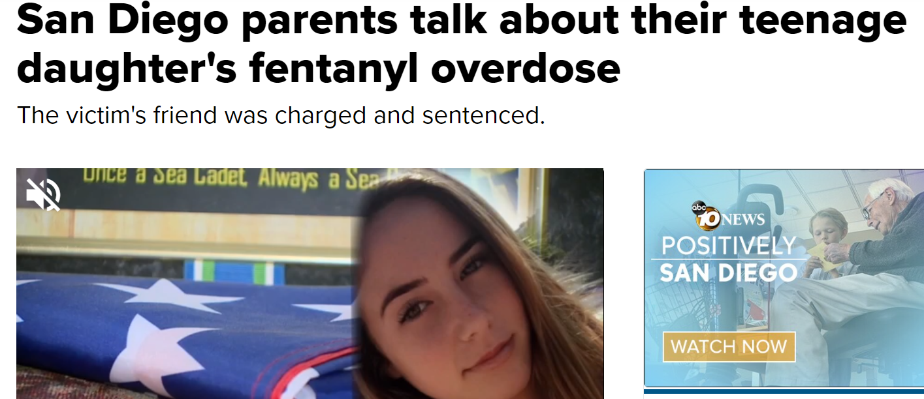
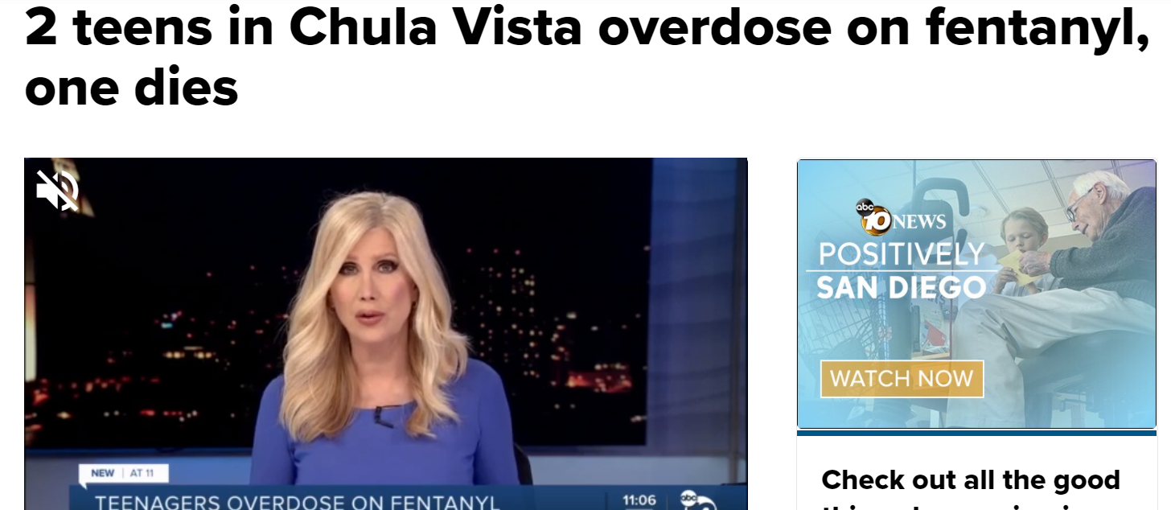
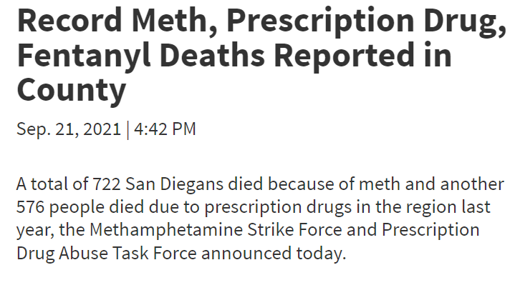
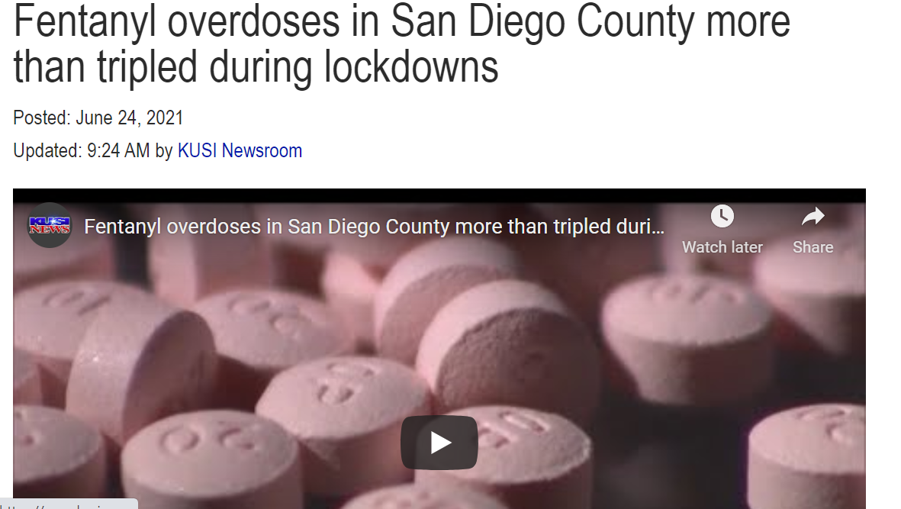
Fentanyl is Here…

Slide 3
Fentanyl is Here with Deadly Consequences
80% of overdose deaths in children 17 and under caused by fentanyl poisoning (YR 2021).

Slide 4
Today, We Will Discuss …
What is fentanyl?
How big is the problem?
What can we do?

Slide 5
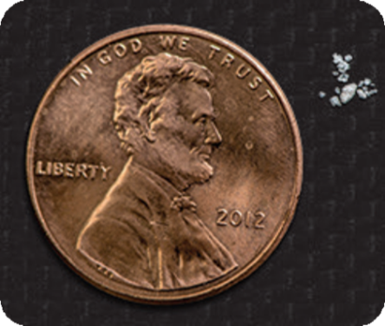
Fentanyl is an Opioid
Opioid is a class of drugs used to reduce pain
Examples
Oxycodone (OxyContin)
Hydrocodone (Vicodin)
Fentanyl
Morphine
Methadone
Prescription Opioids
Prescription opioids are prescribed by doctors to treat moderate to severe pain.
Illegal Fentanyl
Illegally sold for its heroin-like effect. Often pressed into counterfeit pills or mixed with other drugs with or without the user’s knowledge.
Heroin
Heroin is an illegal opioid. Heroin comes in powder form or as black tar heroin.
Illegal Fentanyl
Synthetic (man-made) opioid 50 to 100 times more powerful than heroin and morphine.

Slide 6
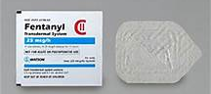
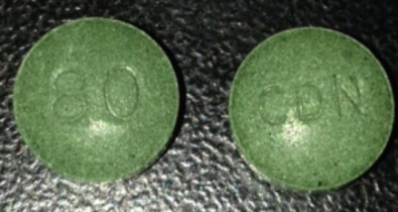
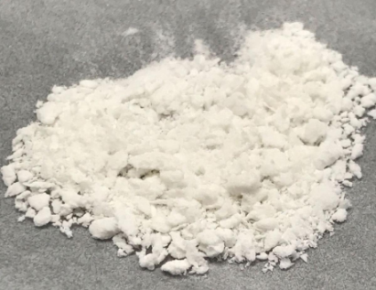
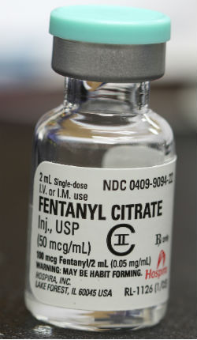
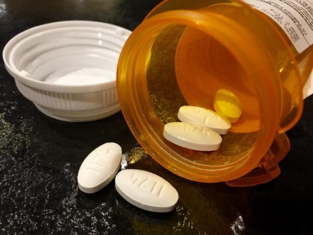
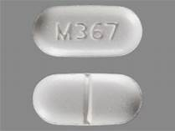
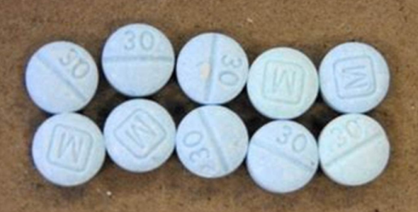
What Does Fentanyl Look Like?
Prescription Fentanyl
Illegal Fentanyl

Slide 7
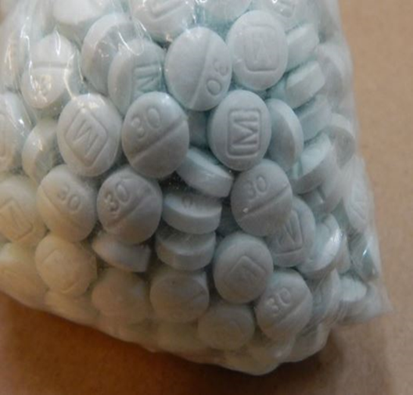
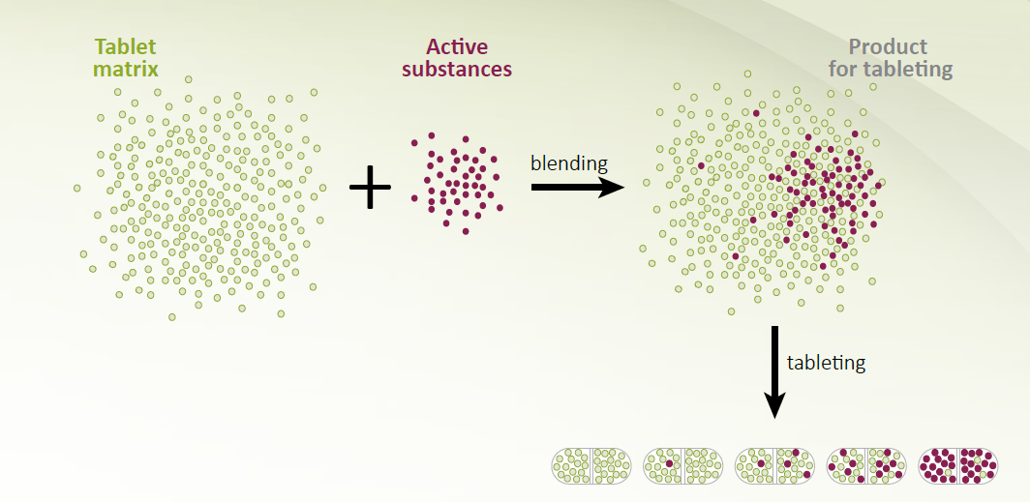
Fentanyl Mixing

Slide 8
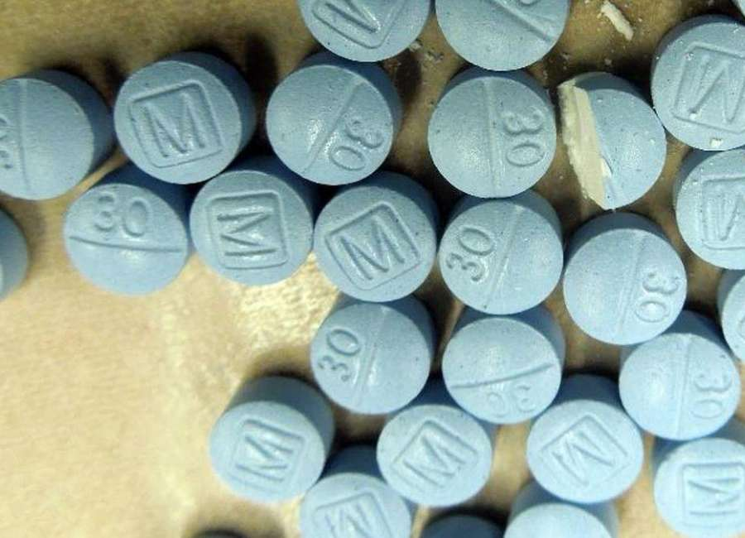
Command Street Names
Pills
Powder
Other
M-30
Blue
Perc 30
Mexican Oxy
Roxy
Beans
Blueberries
Perc
Fetty
Fire
Fettywap
Confetti
Fet
White
Pasta/ Fettuccini
China girl/ white/ Town
Great Bear
Poison
Tango and Cash
Murder 8
Jackpot
Goodfellas
He-Man
Friend
Dance Fever
Apache

Slide 9
How is Fentanyl Used?
Swallowed
Snorted
Smoked
Injected

Slide 10
The Rise of Fentanyl in San Diego
How Big is the Problem?

Slide 11
Fentanyl is the #1 substance found
in overdoses.
462
151
92
33

Slide 12
San Diego County Adult Arrestees Self-Report Naloxone Administration, 2020
How many times naloxone administered?
45% of those that overdosed reported they had been administered naloxone.
58% 1 time
12% 2 times
31% 3 times

Slide 13
The Rise of Fentanyl in San Diego
Why is this Occurring?

Slide 14
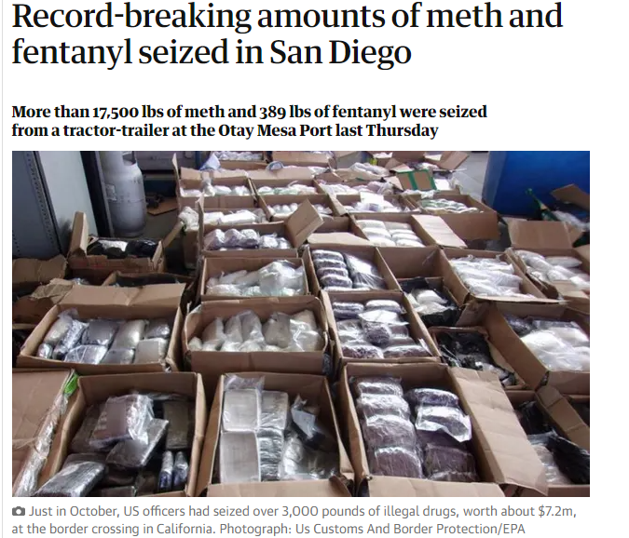
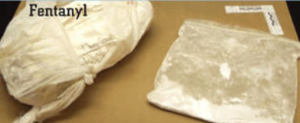
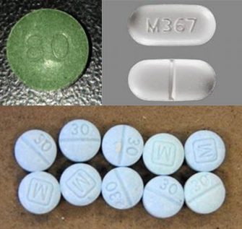
Fentanyl Seizures
142%
increase in
Fentanyl seizures

Slide 15
Notes:
.

Slide 16
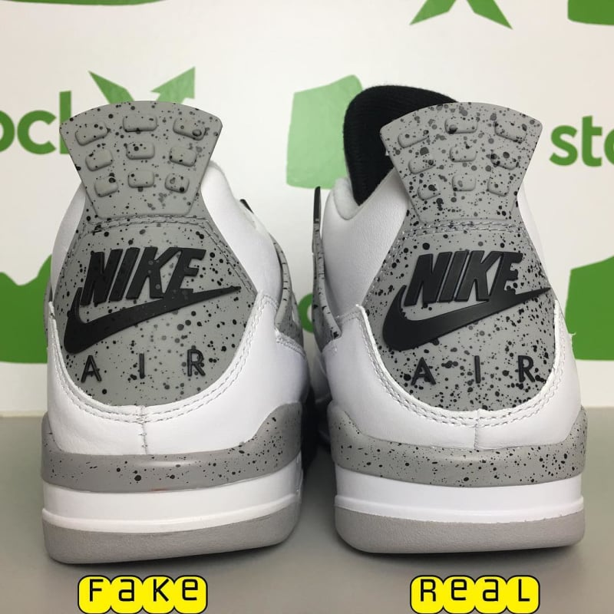
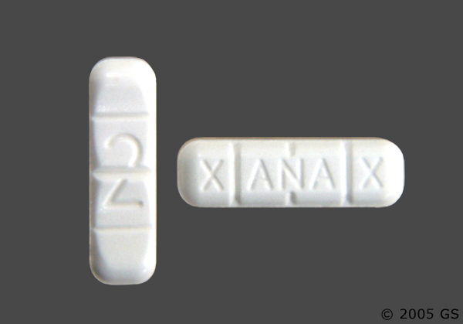
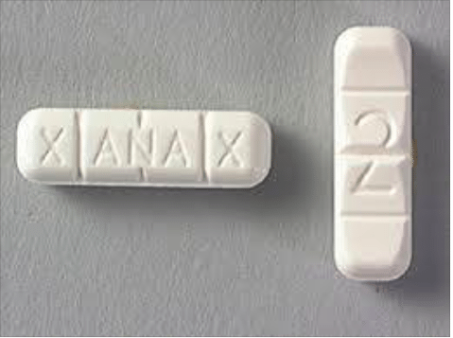
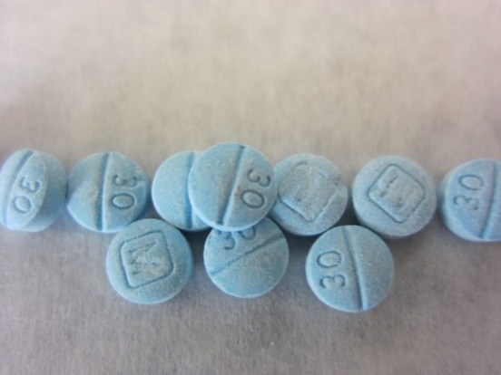
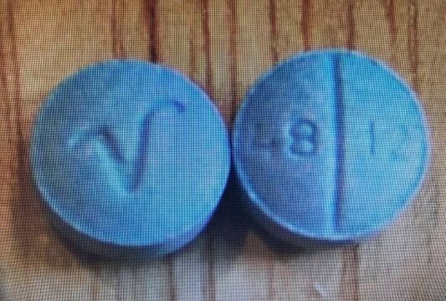
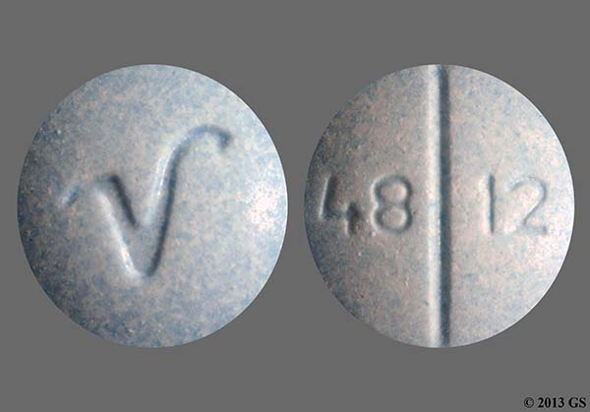
Game Break: Can You Spot the Real Thing?
1
2
FAKE
FAKE
FAKE
FAKE
FAKE
FAKE
FAKE
PERCOCET
FENTANYL-LACED PILLS

Slide 17
Why is this Occurring?
Buying
Social media sites
Text messaging
Sharing
Parties
Homes
Out with friends
Fentanyl is easy to get.

Slide 18
What’s Driving Substance Use?
Curiosity
Stress Relief
Dependence
Be especially careful if your child has been prescribed a pain reliever

Slide 19
The Rise of Fentanyl in San Diego
What can we do?

Slide 20
What Can We Do?
All of us must make use of the effective tools that are available to families, healthcare professionals, educators, community leaders and law enforcement.
Prevention
Intervention& Treatment
Harm Reduction
Find Help
Healthy choices
Identify those in need
Naloxone
Treatment available
Empowerment and education
Take action
Fentanyl
test strips
Recovery is possible

Slide 21
California’s Good Samaritan Law can
protect you from simple drug possession charges
Together we can
#StopOverdoses
Suspect an
Overdose?
Stay & call 911

Slide 22
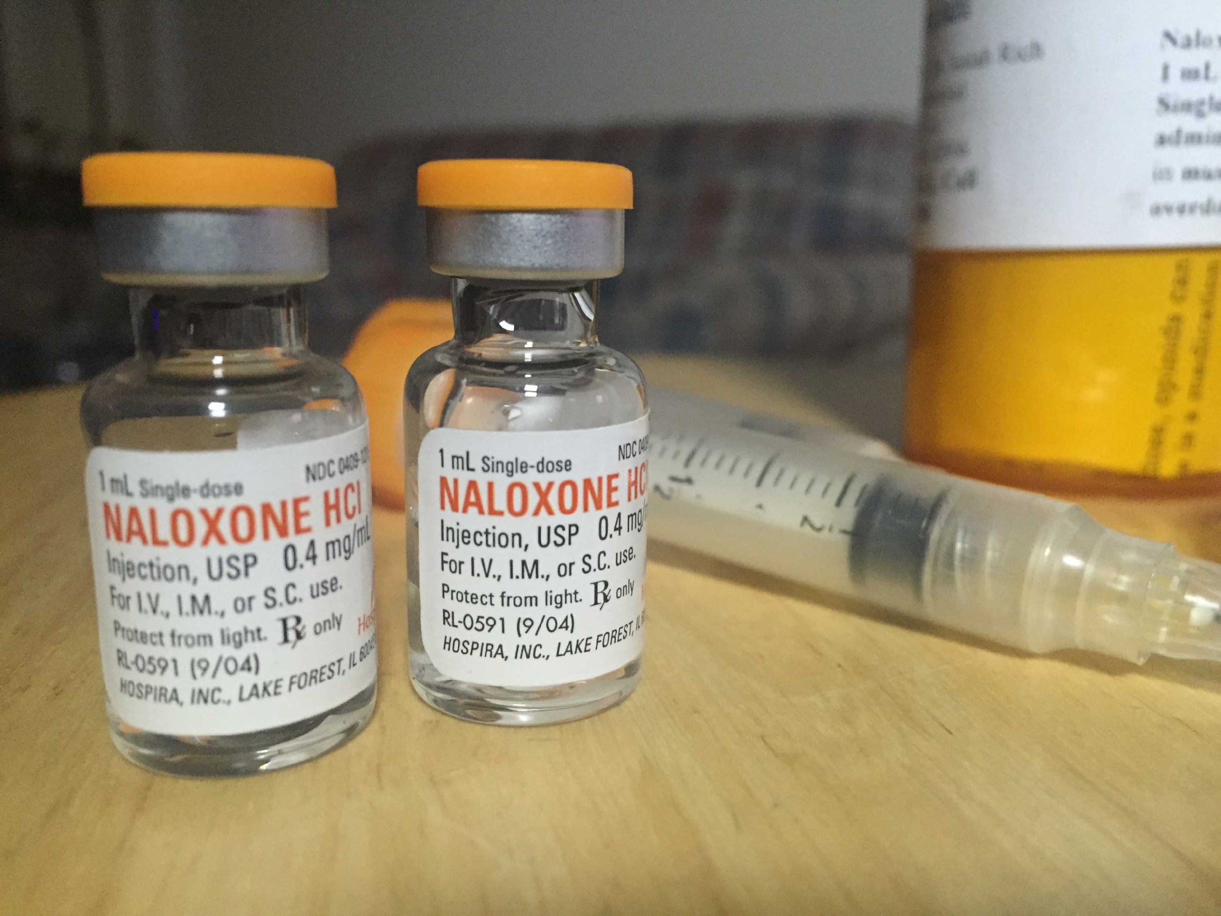
Know Signs of Overdose
Heavy nodding, deep sleep, hard to wake up, or vomiting
Slow or shallow breathing (less than 1 breath every 5 seconds), snoring, gurgling or choking sounds
Pale blue or gray lips, fingernails, or skin
Clammy, sweaty skin
Administer Naloxone to reverse an overdose, but always call 911 FIRST

Slide 23
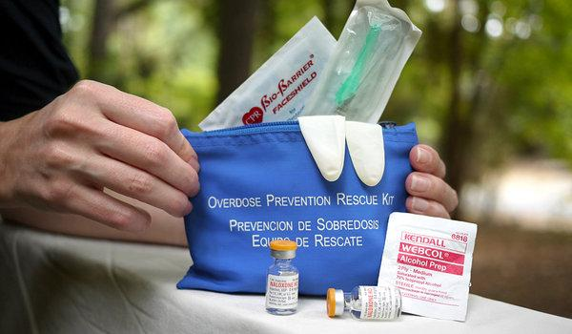
Save a Life – Carry Naloxone
Naloxone can save the life of a person experiencing an overdose
Naloxone counteracts opioids and can restore breathing and heart rate
Make it a part of your home first-aid kit: It’s easy to get a naloxone kit and get trained on how to use it

Slide 24
When Possible, Ask for Non-Opioid Alternatives for Managing Pain
Non-steroidal
Anti-Inflammatory drugs (NSAIDS)
Acetaminophen
Local Anesthetics
Alternative Approaches
Motrin
Advil
Aleve
Tylenol
One shot or multiple shots
Acupuncture
Physical Therapy
Massage

Slide 25
Secure/Dispose of Medications in Home
Find prescription drug
drop off locations at
Sdpdatf.org
Store prescribed medications in a secure place
Properly dispose of unwanted or expired medication

Slide 26
The Rise of Fentanyl in San Diego
What Can Parents and Caregivers Do?

Slide 27
Talk Early, Talk Often
Show concern rather than anger
Ask open-ended questions
Work to understand your teen’s point of view
Establish a Rescue Plan

Slide 28
Is Your Child at Higher Risk?
Traumatic events
Impulse Control Difficulties
Diagnosed or undiagnosed mental health issues
Depression
Anxiety
Attention Deficit Hyperactivity Disorder (ADHD)
Increased Risk for Substance Use
Family history of substance use

Slide 29
Monitor Social Media
Talk with them about what they are seeing and posting
Take note of social media sites your child visits
Keep track of passwords and usernames
Set limits on the amount of time they are online

Slide 30
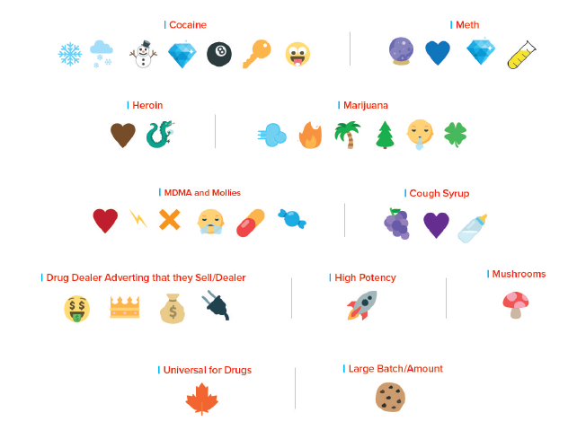
Look for Popular Emoji Drug Codes

Slide 31
© Can Stock Photo / artofphoto
I took percs and fentanyl and now I can barely breathe.
I'm scared to go back to jail. Please don't tell.
Call your mom now. You're not alone.
You have a lot more to lose than you realize.
I can't breathe

Slide 32
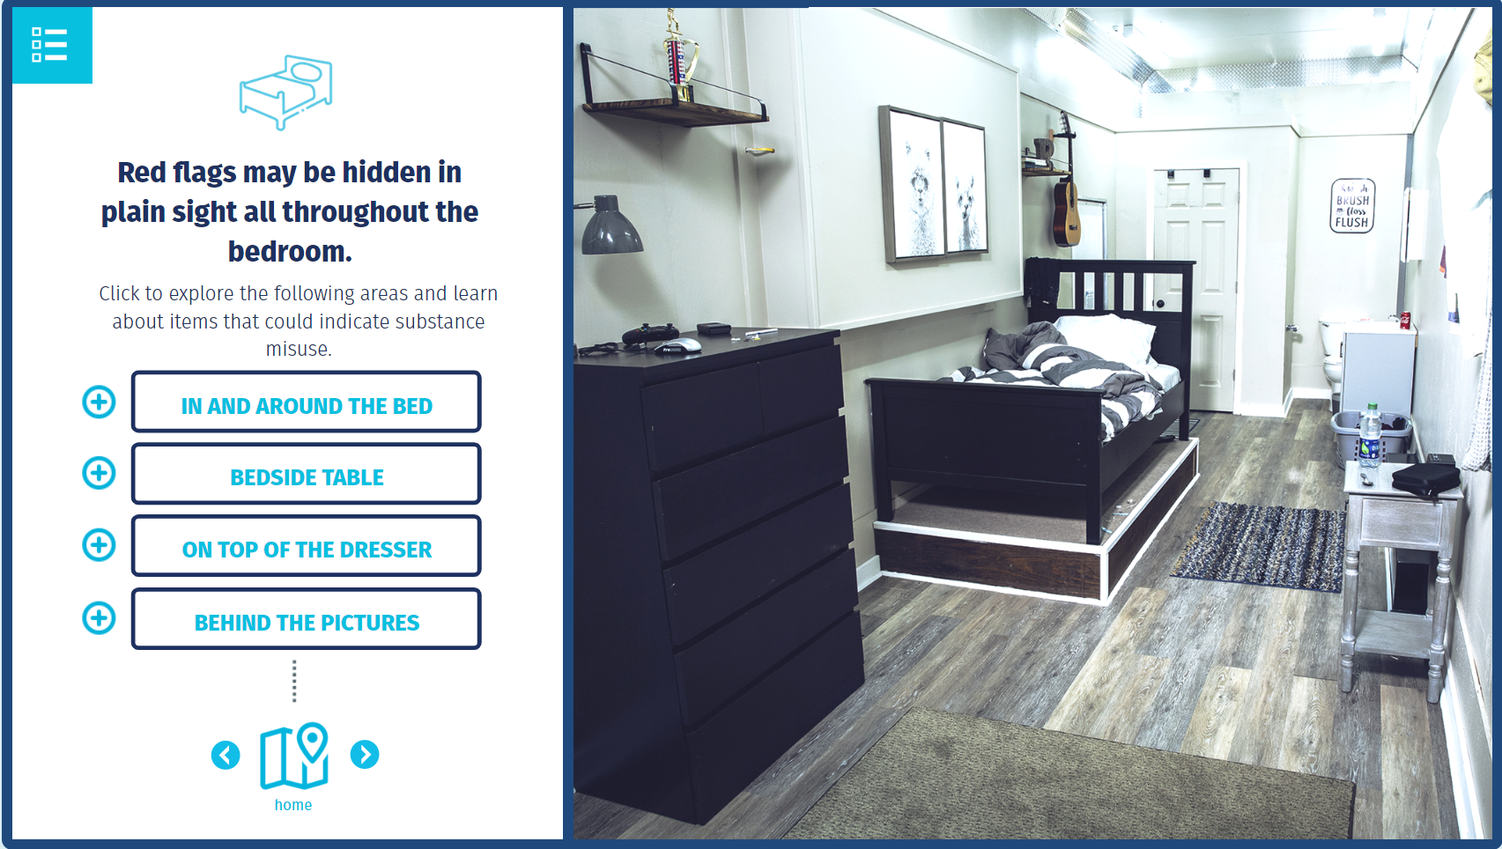
Learn How to Spot Signs of Drug Addiction
Learn to spot the
red flags
that your teen might be hiding in his/her bedroom
https://www.raliusa.org/

Slide 33
If Your Teen is Using Opioids or Counterfeit Pills
The body develops “tolerance” and “dependence”
Have to use more and more of a drug to achieve the same feelings
No longer get a good feeling when they use because their body has adjusted to having excess in their system
Stopping use can result in withdrawal
Muscle aches; restlessness; anxiety
Diarrhea; abdominal cramping; nausea and vomiting; rapid heartbeat; high blood pressure
Emotional withdrawal can last for months
High risk of relapse during first months of stopping

Slide 34
If your Teen is Using Opioids or Counterfeit Pills
Ensure Safety
Get Your Child an Evaluation
Suggest Treatment

Slide 35
Resources

Slide 36
Need Help with Opioids?
Sdpdatf.org

Slide 37
Seek Treatment Options
Ask questions
Support recovery
Self-care

Slide 38
San Diego Resources
County’s Access and Crisis line – (888) 724-7240
2-1-1 San Diego- 211sandiego.org
up2sd.org
Sdpdatf.org

Slide 39
Thank you!

