Slide 1
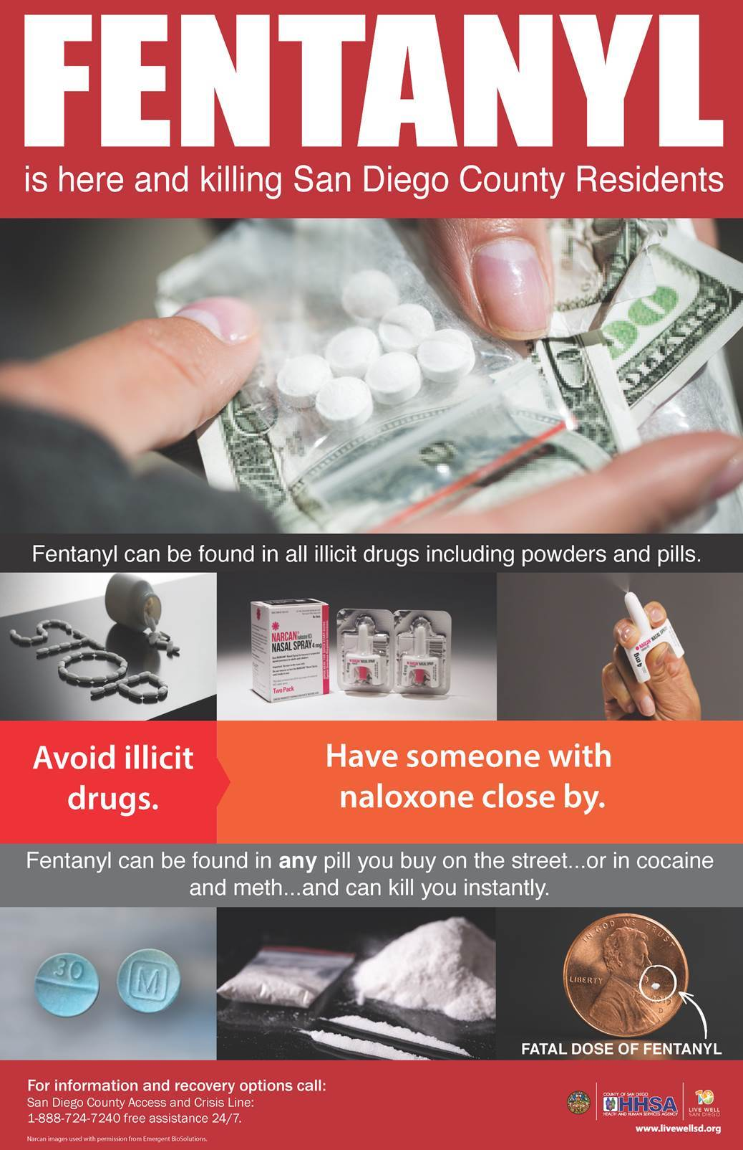
San Diego and Imperial County
Hospital Fentanyl Testing Project
Roneet Lev, MD
Former, CMO, ONDCP
Emergency, Addiction Physician Scripps Mercy Hospital

Slide 2
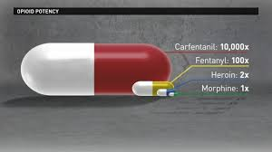
What is Fentanyl?
Fentanyl is a synthetic opioid that is 100 times more potent than morphine.
As little as 2 mg of fentanyl can kill.
Lethal Fentanyl comes from China or Mexico, not hospitals and pharmacies.
It is mixed into other illegal drugs.
Roneet Lev, MD
Roneet Lev, MD

Slide 3
The Fentanyl Epidemic in US
Roneet Lev, MD
CDC Wonder Data, SOOTM – Synthetic Opioid Other Than Methadone
Roneet Lev, MD

Slide 4
The Fentanyl Epidemic in San Diego
Fentanyl Overdose Deaths
2020 - over 1 death a day
77% male
Average age 37 (range 14 – 76 )
Roneet Lev, MD
Roneet Lev, MD

Slide 5
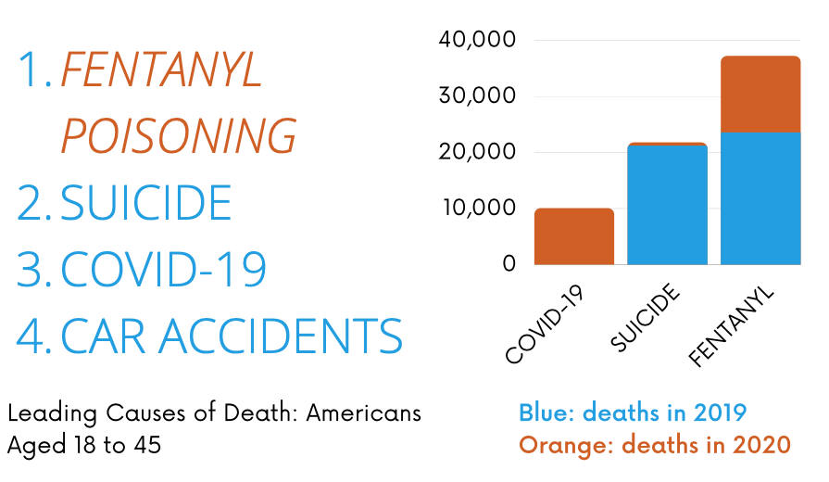
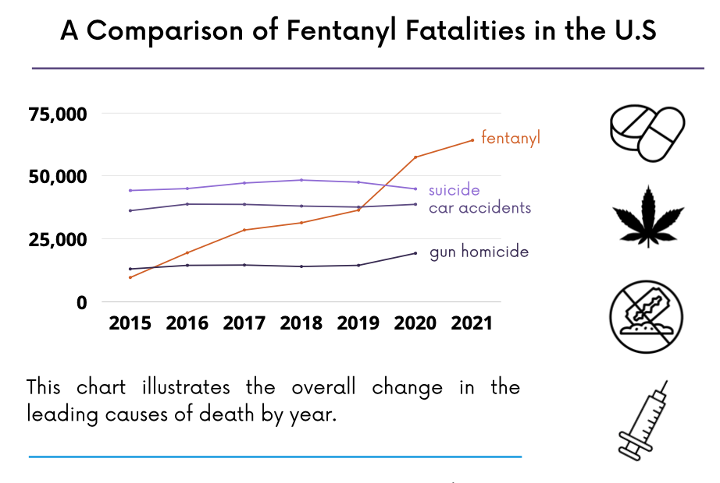
Fentanyl Fatalities
Fentanyl is the #1 cause of death age 18 – 45
Fentanyl Fatalities increase nearly 50% in 12 months as of April 2021
Fentanyl is tied to 64% of total drug fatalities
Fentanyl kills one person every 8.57 minutes
https://www.cdc.gov/nchs/fastats/deaths.htm
https://www.cdc.gov/nchs/data/vsrr/VSRR016.pdf
https://wisquars.cdc.gov/fatal-leading
https://wonder.cdc.gov/controller/saved/D157/D242F834
Roneet Lev, MD
Roneet Lev, MD

Slide 6
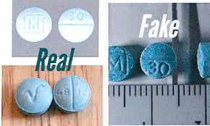
Where is Fentanyl found?
Heroin – 50% of heroin deaths included fentanyl
Cocaine – 50% of cocaine deaths included fentanyl
Methamphetamine – 25% of methamphetamine deaths included fentanyl
Fake hydrocodone pills
Fake oxycodone 30 pills (M30)
Fake hydrocodone pills (yellow)
Fake Xanax pills
Vaping products
Roneet Lev, MD
Roneet Lev, MD

Slide 7
Fentanyl Testing Landscape
Rapid drug testing can change immediate clinical decisions when available in real time (within 1 hour).
There is no available FDA approved rapid urine drug panel test that includes fentanyl
Fentanyl reagent are available today to any setting that has a chemical analyzer
FDA should expedite approval of multi drug urine drug screen that includes fentanyl for CLIA waived facilities
Roneet Lev, MD
Roneet Lev, MD

Slide 8
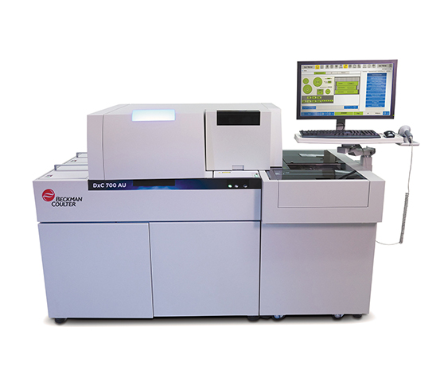
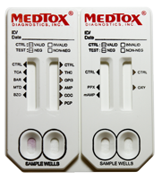
Fentanyl Testing Currently Availability
Fentanyl immunoassay drug testing is available in real time (within 1 hour)
for all hospital that have a chemical analyzer
Fentanyl is a synthetic opioid that does not detected as part of an opioid panel. Detection requires a separate test and reagent.
Fentanyl immunoassay drug test can be sent out with results available in a few days
There are no FDA 510(k) cleared point of care rapid urine strip test for fentanyl that is part of a multi-drug panel.
San Diego sent a letter to FDA requesting emergent use of such test
X
X
All standard chemical analyzes can utilize fentanyl immunoassay reagents
There are no FDA approved point of care urine strip test for fentanyl that is part of a multi-drug panel
Roneet Lev, MD
Roneet Lev, MD

Slide 9
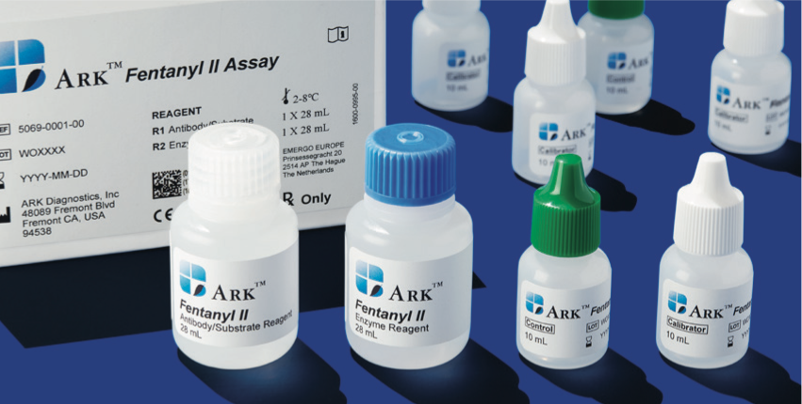
Fentanyl Reagents – 501K cleared
Ark Diagnostics ARK Fentanyl II assay (1 ng/ml fentanyl, cross reacts with norfentanyl)
Direct from Ark
Sekisui – ARK Fentanyl II assay (with Ortho Vitros chemical analyzer)
Siemens
MedTest – Pointe Scientific fentanyl assay (5ng/mL norfentanyl)
MedTest Pointe Scientific distributes the assay made by Lin-Zhi
Thermo Fisher DRI Fentanyl assay (2 ng/ml fentanyl)
for forensic use, needs confirmation
Roche analyzers
Abbott/ Immunalysis
HEIA first generation: 2 ng/ml fentanyl, does not detect norfentanyl)
SEFRIA technology: 1 ng/ml fentanyl, does not detect norfentanyl
Roneet Lev, MD
Roneet Lev, MD

Slide 10
Ordering Fentanyl Reagents (from ARK)
1. It should be easy for hospitals to order the fentanyl assay from ARK or the other manufacturers as they order chemistry tests and lab equipment routinely. For ARK specifically, our website www.ark-tdm.com has a Contact tab to click and it gives email addresses for various types of support (Sales Inquiries salesinquiries@ark-tdm.com). They send an email saying they are interested in the Fentanyl II assay and someone at ARK will contact them quickly.
2. Once we establish contact, we need to know what general chemistry system they will be using and we will send them an application sheet with the settings for the Fentanyl II assay. They simply enter those settings on the system. ARK also sends a free of charge kit or two for them to use to validate the assay in their lab. All labs know how to do this.
3. We then ask them to fill out a Customer Data Sheet (1 page) with basic information such as the hospital name and address, contact names, etc. so that we can enter them into our system and be able to process an order and ship it.
4. ARK also has a simple Terms and Conditions Sheet (1 1/2 pages) for them to review and sign. There is always something that they want to change, but it is usually very easy.
5. We obviously give pricing for the assay and they can order and get it within 2 days, mostly one day.
6. ARK's assay is FDA 510(k) cleared. The other manufacturers who have FDA 510(k) cleared Fentanyl assays are Abbott (Immunalysis) and Lin Zhi. Thermo Fisher has the DRI branded Fentanyl assay, but it is not FDA 510(k) cleared. It is labeled as Forensic Use Only. However, we recently signed an agreement with Thermo Fisher where we make our Fentanyl II assay for them using their branding. It's the same assay, but with different labeling. They call it the DRI Fentanyl II assay to distinguish it from their other Fentanyl assay. So, it is FDA cleared. Thermo Fisher can only sell it to customers who have certain general chemistry systems though, not all general chemistry systems. Finally, Siemens distributes the ARK Fentanyl II assay for Siemens branded general chemistry systems.
Roneet Lev, MD
Roneet Lev, MD

Slide 11
The Gold Standard for Hospital Drug Testing
THE ISSUE
Fentanyl does not show up on a standard drug screen because it is a synthetic opioid , it requires a separate test
If a provider is concerned about THC, Cocaine, Methamphetamine, PCP or opioids, they should also be concerned about fentanyl
THE GOLD STANDARD
Any time a urine drug test is ordered in a hospital setting, it should automatically include fentanyl along with all other drugs
SOLUTION
1. Purchase Fentanyl reagent for hospital chemical analyzer
2. Create IT solution that automatically includes fentanyl with urine drug screen
Roneet Lev, MD
Roneet Lev, MD

Slide 12
How a positive Fentanyl Test can save lives
Warn a provider
Warn a patient
Warn friends
Rx for naloxone
For the patient
For friends & loved ones
Connect to treatment / motivation to change
Assist clinics and doctors' offices that do not have access to real time testing
Roneet Lev, MD
Roneet Lev, MD

Slide 13
San Diego Increased Fentanyl Testing Capacity
Alvarado
El Centro
Kaiser San Diego
Kaiser Zion
Navy Camp Pendelton
Navy Balboa
Palomar Health - Escondido
Palomar Health - Poway
Paradise Valley
Pioneer
Rady Children
Scripps Encinitas
Scripps Green
Scripps La Jolla
Scripps Mercy - CV
Scripps Mercy - SD
Sharp - CV
Sharp - Coronado
Sharp- Grossmont
Sharp - Memorial
UC Health - La Jolla
UCSD- Hillcrest
Tri-City
VA - Health
15 out of 24 Hospitals test for Fentanyl
Increase from 17% (4) to 62.5% (15) in 10 months
Roneet Lev, MD
Roneet Lev, MD

Slide 14
San Diego Hospital Real Time Fentanyl Testing Capability
Automatic Testing – all urine drug screen automatically include fentanyl
Need to Request – hospital has capacity for real time testing, but a doctor need to place a separate order
No Testing – no in house testing is available, but can request to sent out the specimen for testing
Automatic Testing | Need to Request | No Testing
Sharp Grossmont | Scripps Mercy - SD | Kaiser - Zion
Sharp Memorial | Scripps Mercy - CV | Kaiser –Kearny Mesa
Sharp Chula Vista | Scripps Encinitas | Paradise Valley
Rady Children’s | Scripps Memorial | Alvarado
Tri-City | Scripps Green | Naval Medical Center
UCSD Hillcrest | Sharp Coronado | Camp Pendleton
UCSD La Jolla |  | Veteran’s Administration
Palomar |  | El Centro
Pomerado |  | Pioneer
Roneet Lev, MD
Roneet Lev, MD

Slide 15
Automatic Testing is Gold Standard
Hospitals with automatic testing greatly increase testing and protentional intervention
Scripps offers elective fentanyl testing at all hospitals. With elective testing, fentanyl test were obtained in only 85 cases compared to increased volume at hospitals with automatic testing.
Roneet Lev, MD
Roneet Lev, MD

Slide 16
Goal
Automatic inclusion of fentanyl in random urine drug tests
1. Purchase Fentanyl Reagent
2. IT Solution to automatically include in urine drug screen
Roneet Lev, MD
Roneet Lev, MD
Updated Jan 2022

